Slide 1
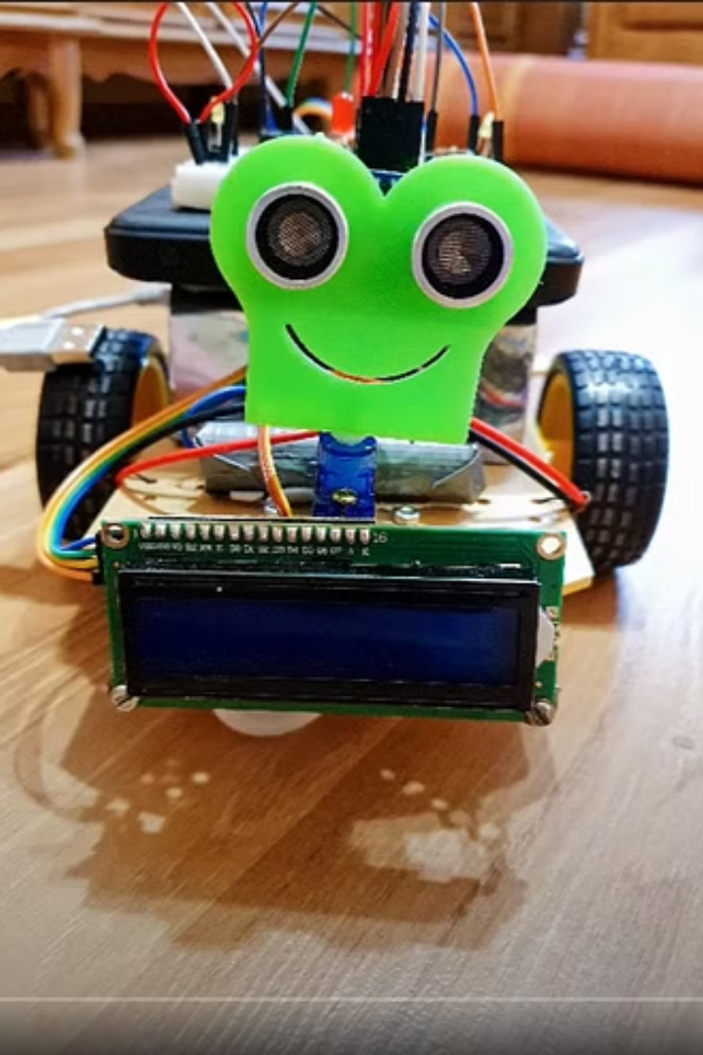
Introduction to Obstacle Avoiding Robots
An obstacle avoiding robot is an autonomous robot that can navigate around obstacles. It's a key application of IoT and robotics.

Slide 2
Components Used in the Robot
Ultrasonic Sensor
Motor Driver
Arduino Board
The ultrasonic sensor measures the distance of obstacles to help the robot navigate.
The motor driver controls the robot's movement, enabling it to navigate around obstacles smoothly.
The Arduino board processes sensor data and controls the robot's actions based on the input.

Slide 3
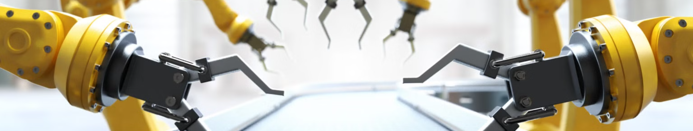
Working Principle of the Robot
1
Obstacle Detection
2
Decision Making
3
Motor Control
The robot uses sensors to detect obstacles in its path.
Based on the sensor data, the robot makes decisions to avoid obstacles.
The robot's movement is controlled in real time to navigate around obstacles.

Slide 4
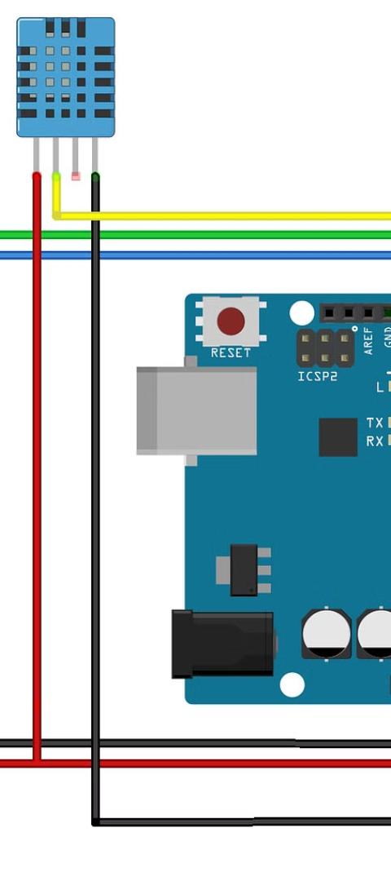
Ultrasonic Sensor and Its Role
Obstacle Detection
The ultrasonic sensor measures the distance to objects using sound waves.

Slide 5


Motor Driver and Its Function
Control
Movement
The motor driver enables precise control over the robot's movement.
It regulates the speed and direction of the robot's movement.

Slide 6
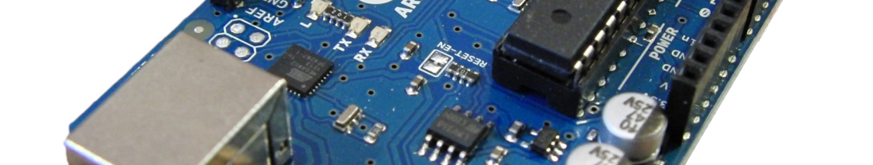


Arduino Board and Its Role
Sensor Data
Action Control
The Arduino board processes data received from sensors.
It controls the robot's actions based on the processed sensor data.

Slide 7
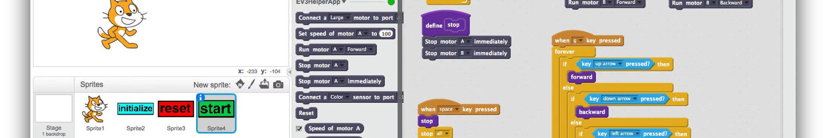
Coding and Programming the Robot
1
Algorithm Development
Creating algorithms to enable obstacle detection and decision making.
2
Software Implementation
Translating algorithms into code to control the robot's movements.
3
Testing and Refinement
Conducting tests and refining the code for optimal performance.

Slide 8

Conclusion and Future Developments
Obstacle avoiding robots have paved the way for advanced autonomous systems. Future developments include enhanced sensor technologies and more sophisticated algorithms for efficient obstacle detection and avoidance.

Slide 9

DONE BY:
R.JAI KRISHNA(III/IV ECE-A)
S.HARSHA VARDHAN(III/IV ECE-A)
RATHAN KUMAR(III/IV ECE-A)

